Slide 1
SMEC Hackathon
Reference id : 6hCLEGO9Sf

Slide 2

Implementation
The zip file containing the eKYC File is generated from the Java-Maven code provided by UIDAI.
The file is then used to upload during booking which will generate a QR Code for users to authenticate during check-in.
The user will verify QR Code containing the filename of the zip file received by the management. It will extract and decode base64 string to get the image
This image will used during Face Recognition for verifying the user.

Slide 3

Behind the Scenes
The UIDAI Authentication and the Booking are Sample Interfaces to illustrate how the website should work.
The software generates QR code every time the user requests for the XML File.
The DeepFace Algorithm was used since the Face-RD Algorithm provided by UIDAI was not working for Stateless Match.
The Face Recognition code also has QR Code scanner uses to decode the QR Code from the webcam.

Slide 4
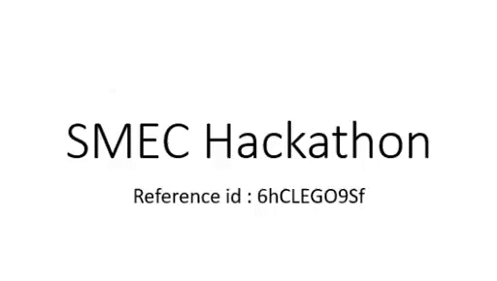
Demo

Slide 5
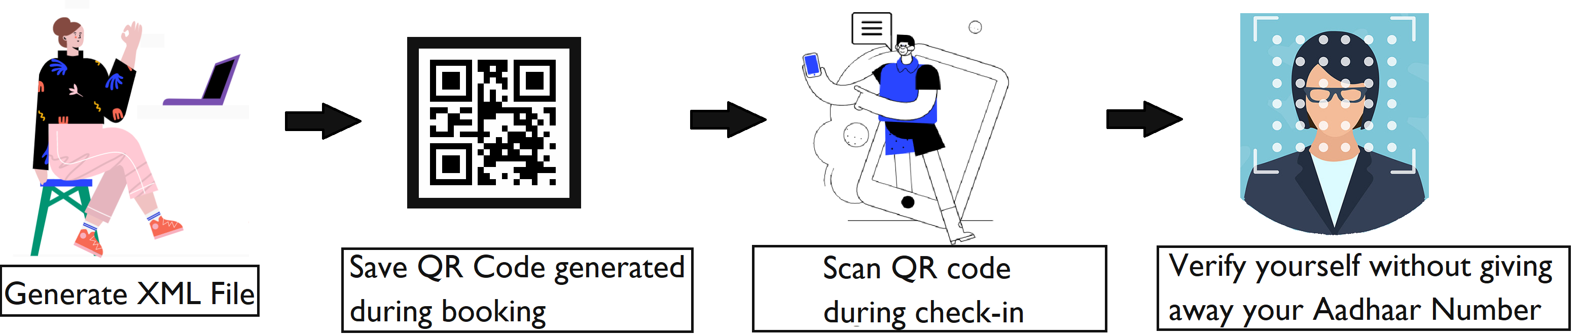
Working
The project uses various different technologies such as Ionic React for Web Development and DeepFace Algorithm for Face recognition.

Slide 6

Future Roadmap
Some of the things that we would like to add to this project in the near future would be:
The Face recognition algorithm currently works on Google colab. If given more time, we would have developed a UI for the same.
The QR Code could also be encrypted and signed to provide an additional layer of security.
The user can also be verified during the time of registration to confirm that it is him/her who is booking.
Made mainly for mobile users, can be upgraded for including others as well.

